Slide 1
Statistical Learning and Data Analysis
Assignment 04 (Classification)
Tarek Saade
Rabeya Siddika Sajia

Slide 2
Motivation
Objective
Why it matters
Interpretability
Predict students’ academic performance level (Low / Medium / High) using study habits, lifestyle, and background characteristics
Understanding which behaviors are associated with better or worse performance can help educational support
Rather than maximizing prediction accuracy alone, the goal is to use interpretable models to explain how different factors relate to performance outcomes

Slide 3
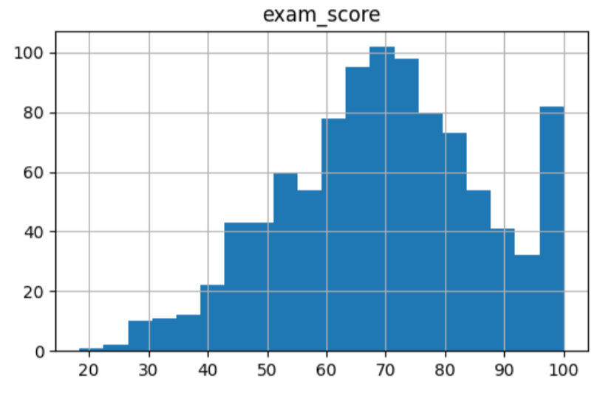
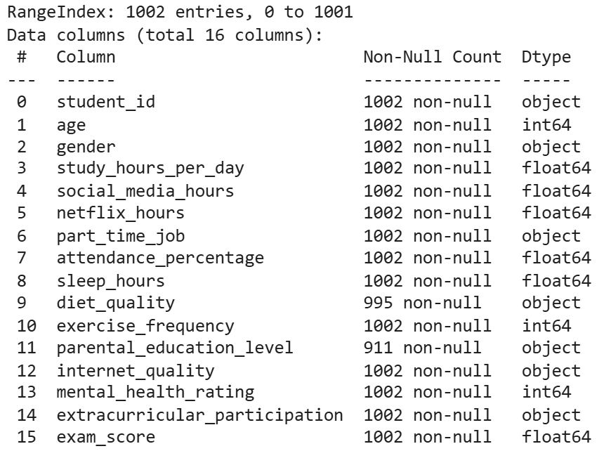
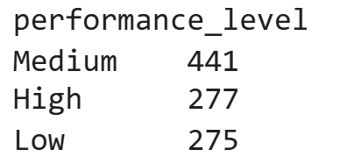
Dataset Overview

Slide 4
Exploratory Data Analysis

Slide 5
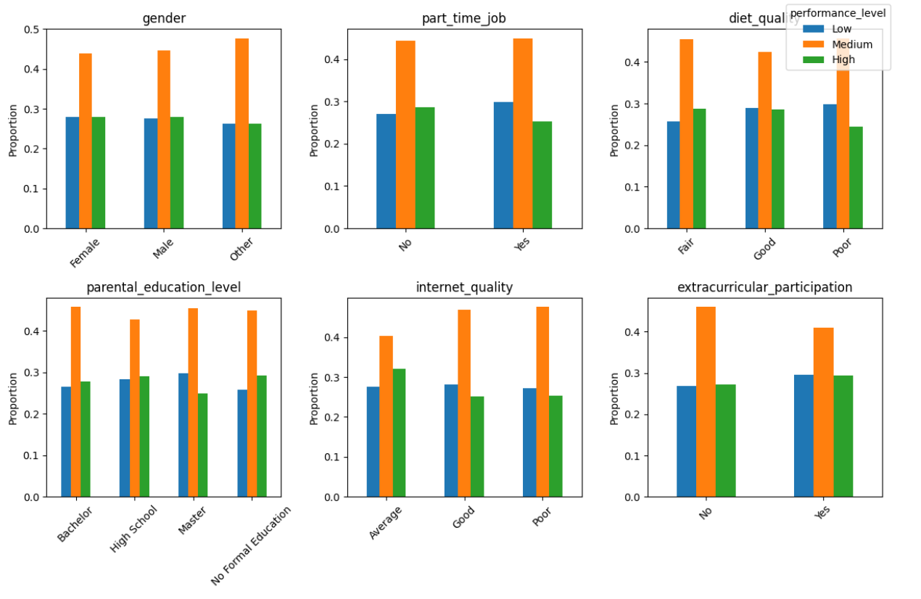
Categorical features

Slide 6
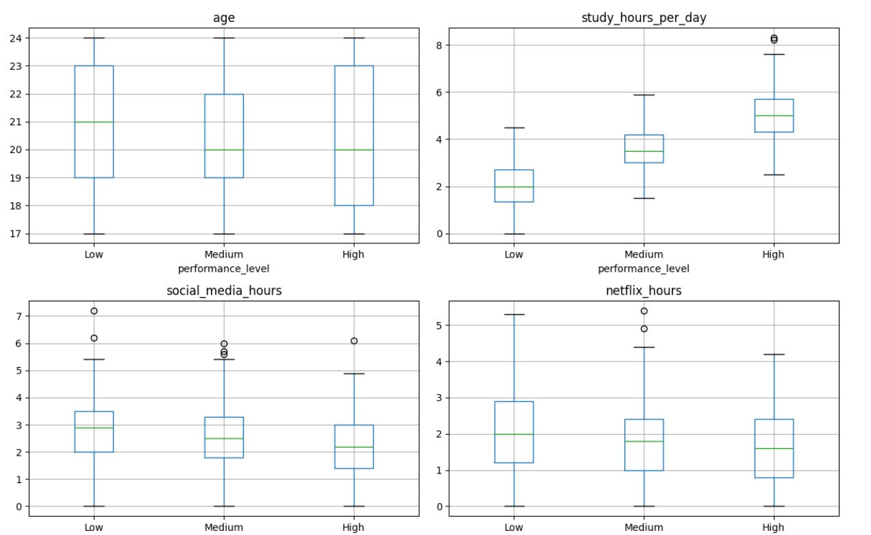
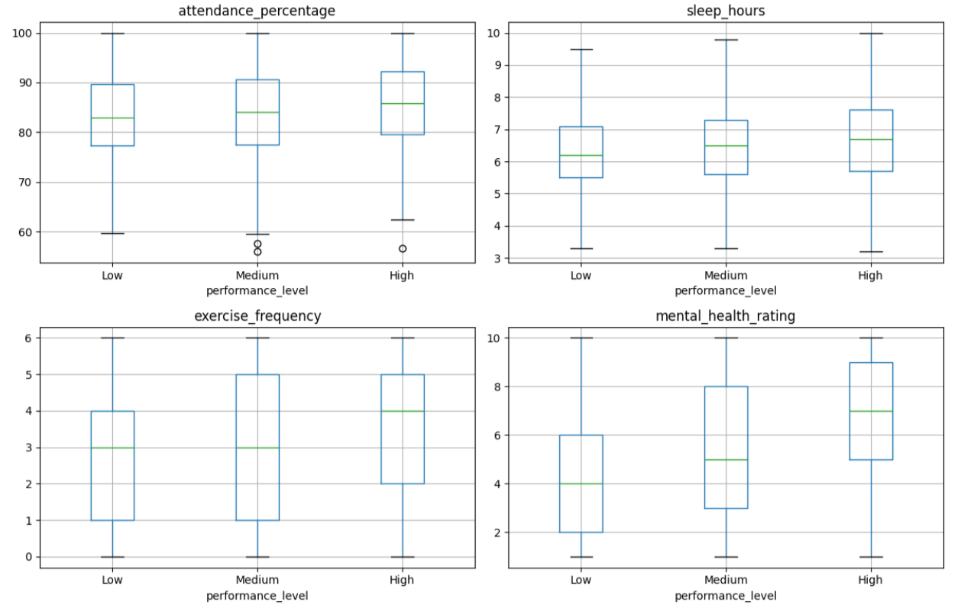
Numerical features

Slide 7
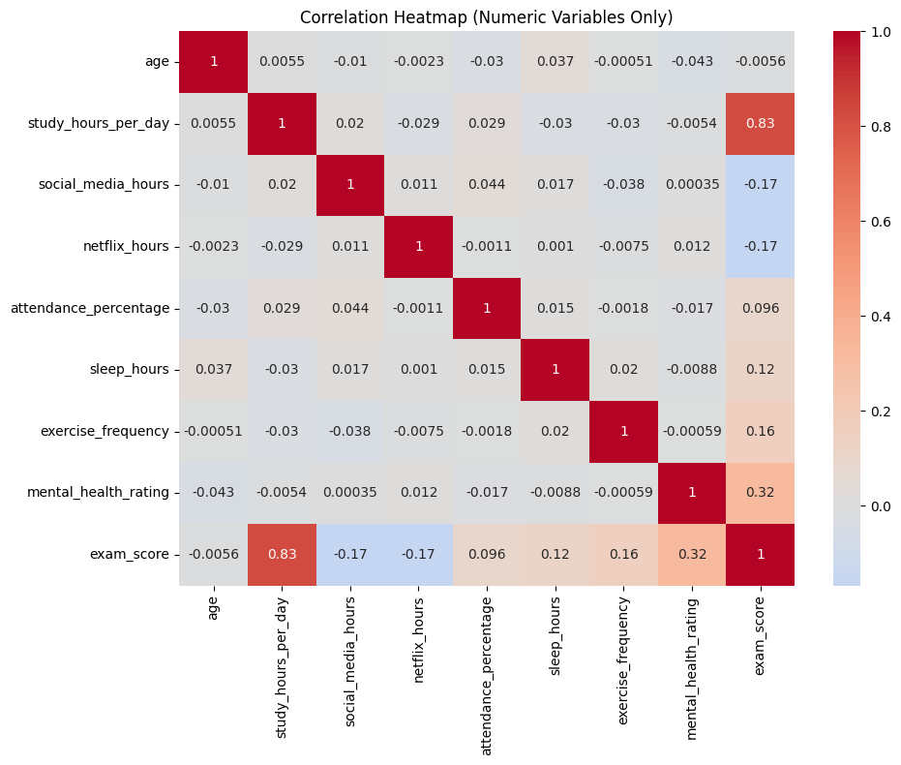
Correlation Heatmap

Slide 8
Pre-processing

Slide 9
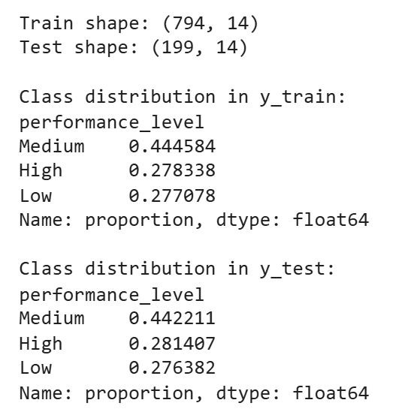
Split data into training and test sets for fair evaluation(80/20).
Separate numeric and categorical features for appropriate preprocessing.
Scale numeric features and one-hot encode categorical features.

Slide 10
Unsupervised learning

Slide 11
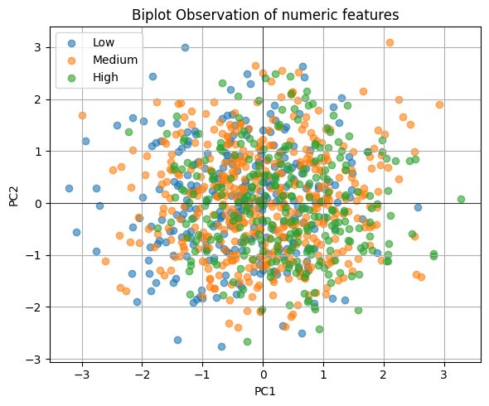
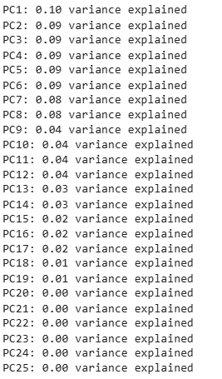
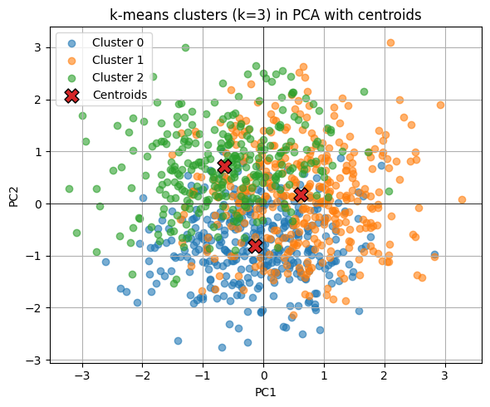
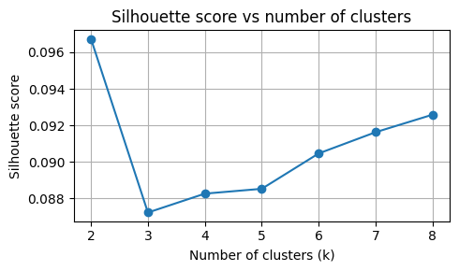
PCA results: Variance spread across many components; first two PCs capture ~27% of total variance.
Visualization: Scatterplot of PC1 vs PC2 shows heavy overlap between performance levels; no clear linear separation.
Clustering: K-means (k = 3) produces weakly separated clusters; silhouette scores are low (~0.09–0.096).
Conclusion: Students’ habits vary gradually; unsupervised methods reveal structure but are not sufficient to separate performance classes.

Slide 12
Supervised learning

Slide 13
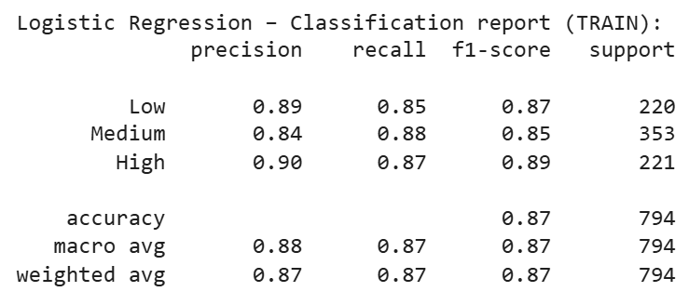
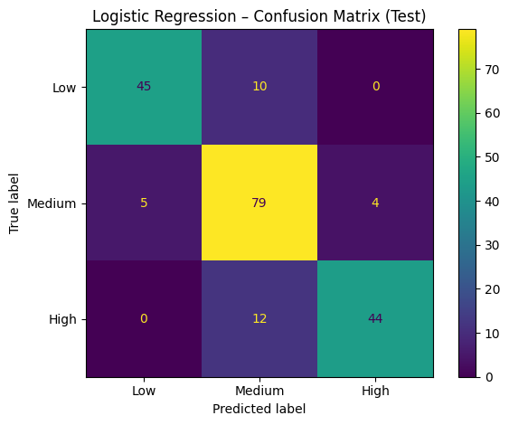
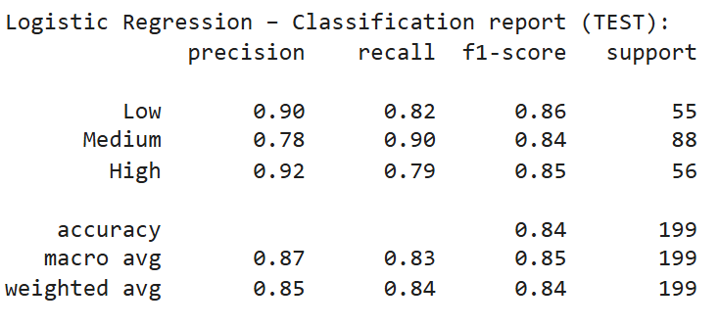
Logistic regression
Key numbers:
Best CV macro F1: 0.837
Training macro F1: 0.87
Test macro F1: 0.85
Test accuracy: 0.84
Interpretation:
Strong and stable performance
Generalizes well
Suggest that much of the predictive signal is approximately linear

Slide 14
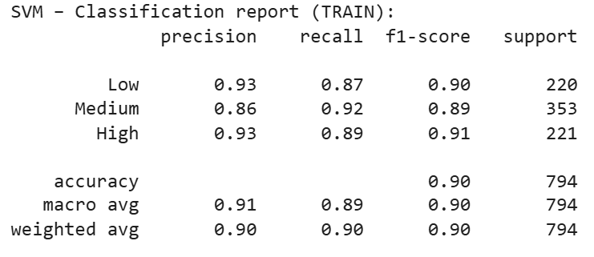
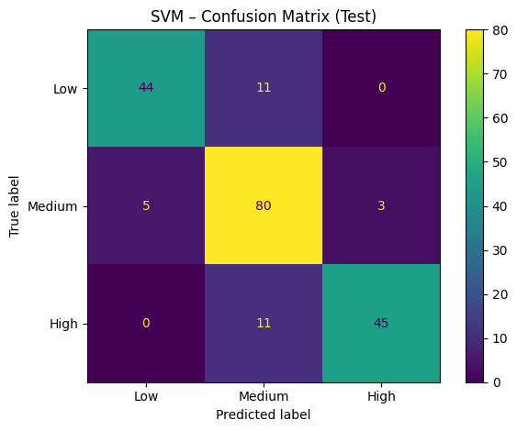
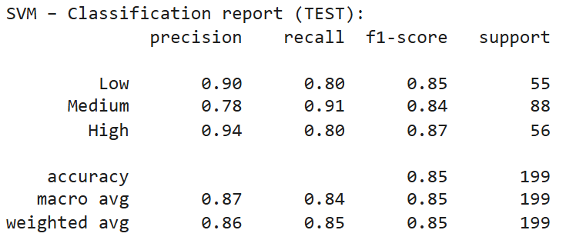
SVM
Key numbers:
Best CV macro F1: 0.830
Training macro F1: 0.90
Test macro F1: 0.85
Test accuracy: 0.85
Interpretation:
Comparable to logistic regression even with non-linear boundaries
Non-linear effects exist but are not dominant

Slide 15
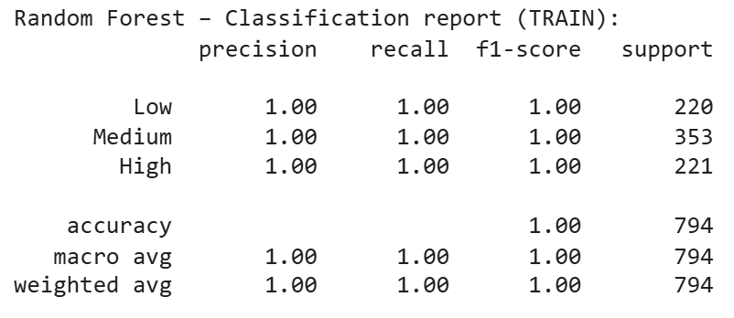
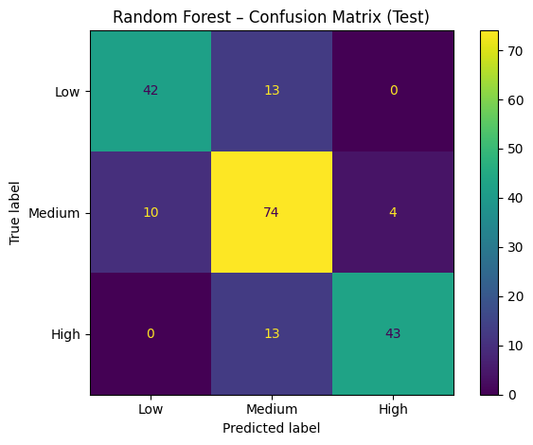
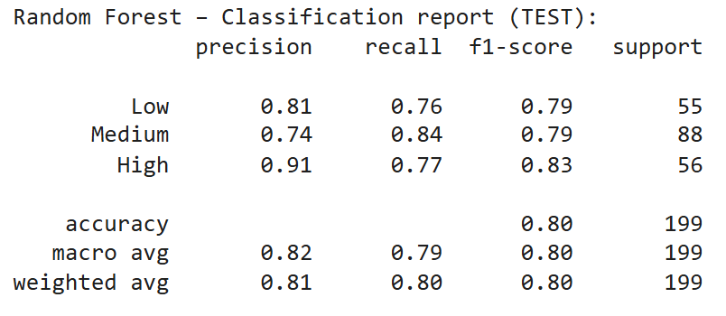
Random Forest
Key numbers:
Training accuracy: 1.00 🚨
CV macro F1: 0.793
Test macro F1: 0.80
Interpretation:
Perfect training performance but drop in cross-validation and test performance, indicating overfitting.
This suggests that the model captures noise rather generalizable patterns.

Slide 16
Interpretation of
Logistic regression

Slide 17
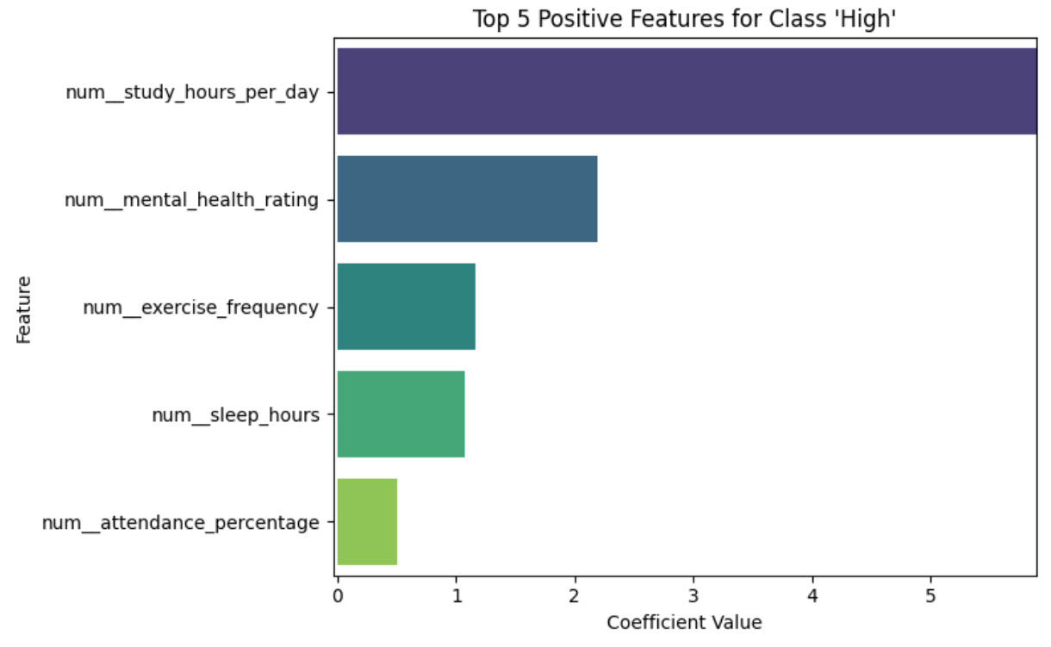
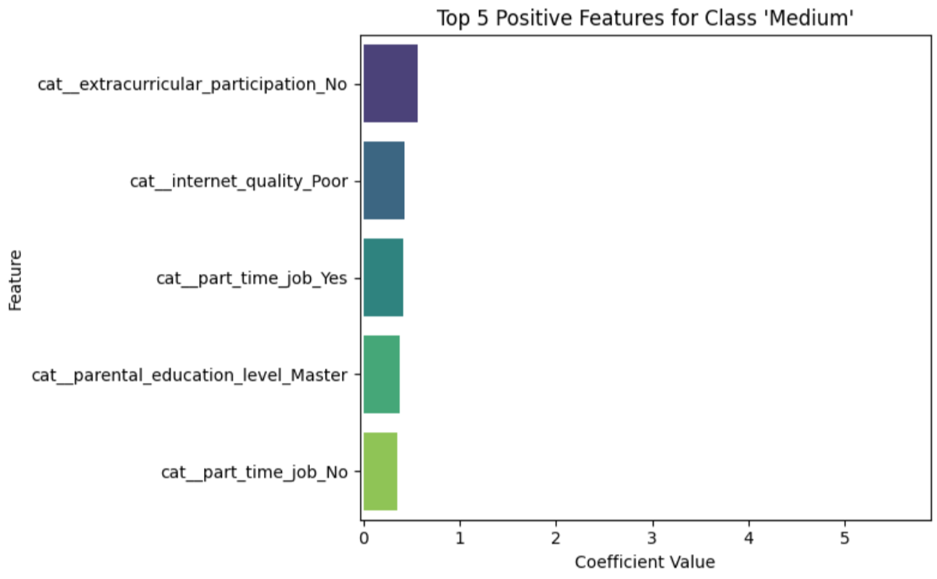
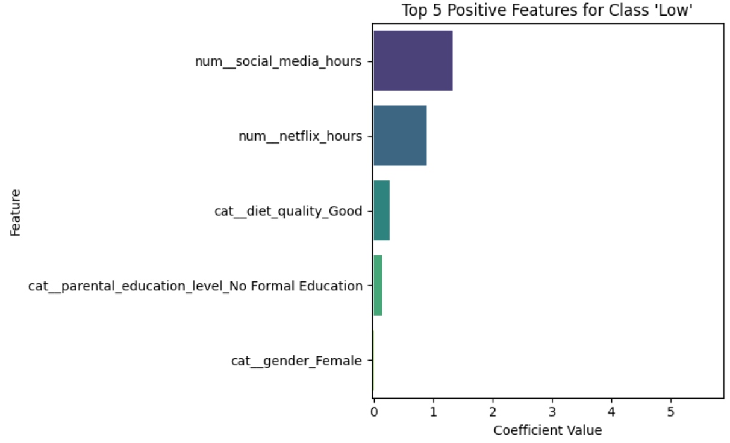
Positive drivers
Coefficient interpretability:
Positive → increase likelihood
negative → decrease likelihood
Odds ratios provide intuitive effect sizes.
High performance
High study hours
Strong mental health
Adequate sleep and exercise
High attendance
Medium performance
Mixed academic and lifestyle patterns
Part-time work and extracurricular activities
Low performance
High social media usage
High Netflix usage

Slide 18
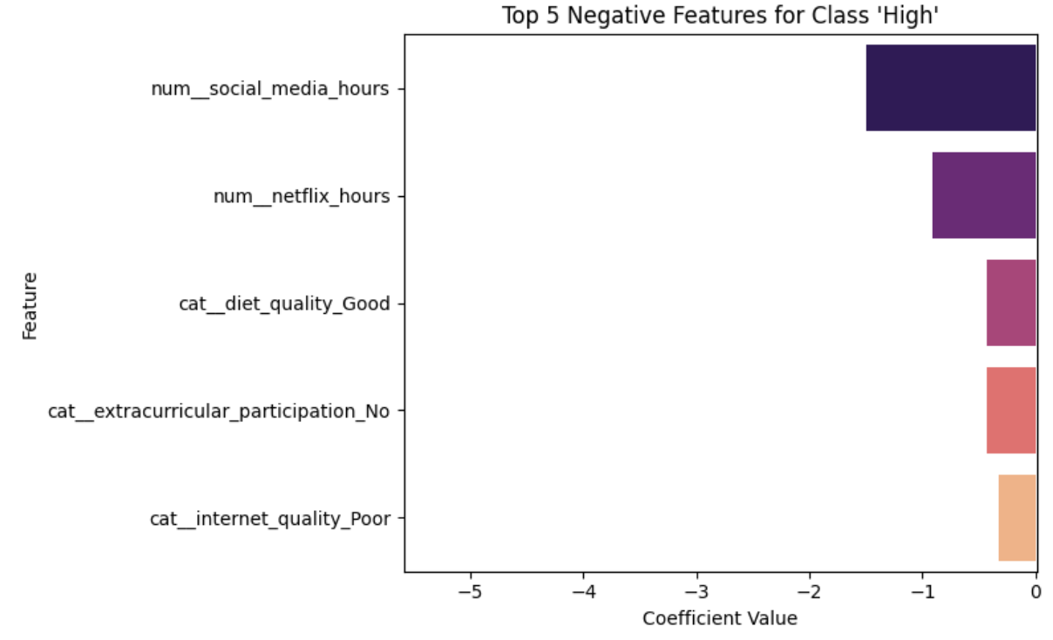
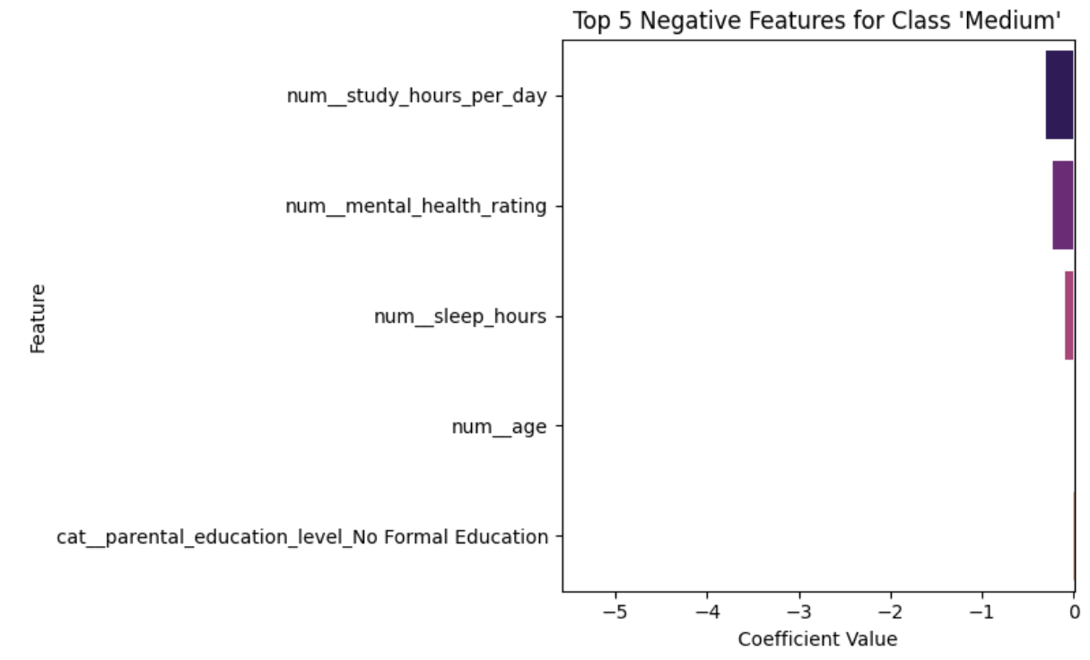
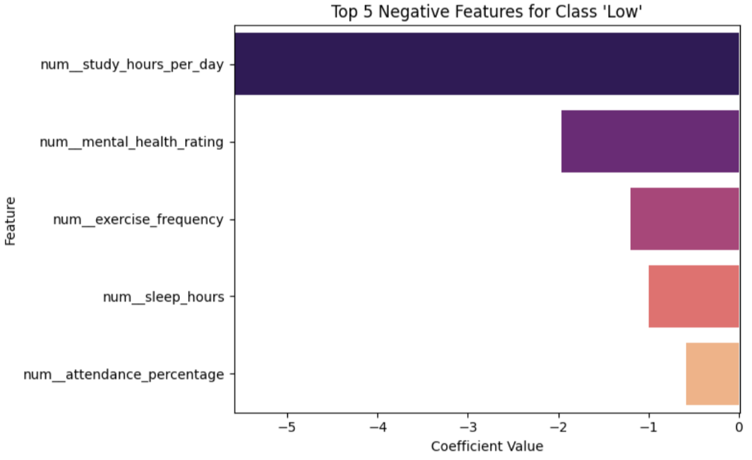
Negative Drivers
High performance
Excessive social media use
Excessive Netflix use
Low performance
High study hours
Good mental health and sleep
Regular exercise and attendance
Medium performance
Strong academic engagement
Very healthy routines

Slide 19
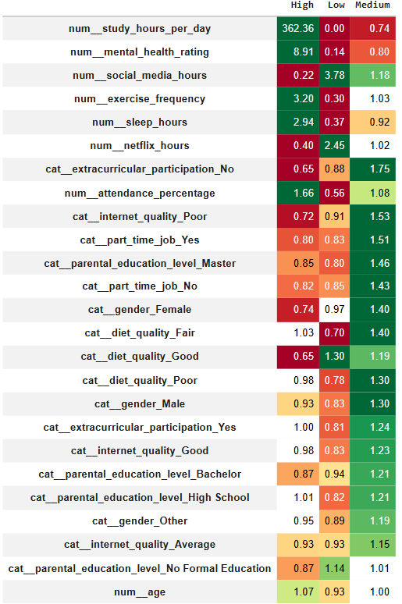
Role of Categorical Variables
Demographic and background variables have small effects
Odds ratios are mostly close to 1
Behavioral and academic habits dominate performance differences
Overall Insights
Performance is driven mainly by controllable behaviors
High performance: sustained study, attendance, sleep, exercise, mental health
Low performance: excessive leisure screen time
Medium performance reflects a balanced, intermediate profile

Slide 20
Final Takeaways
Study habits, attendance, and well-being are strong predictors of performance
Logistic regression provides interpretable insights
✔ What the model can say
Students who study more tend to have higher performance
Better sleep, exercise, attendance, and mental health are associated with higher performance
✘ What the model cannot say
Increasing study hours will cause a student’s performance to improve
Cannot prove that changing habits will directly change outcomes
This is an observational model, not a causal one

